Slide 1
HEALTH MONITORING SYSTEM

Slide 2
Overview
Real time health monitoring of soldiers from headquarters
Detecting external and internal injuries
Providing quick medical support

Slide 3

Assembly and Designing
Temperature
Microcontroller
Pulse
ECG
Accelerometer
Battery

Slide 4
Medical Analysis
Septic Shock
Body temperature
Pulse
Hypovolemic Shock
Systolic Blood Pressure
Rapid Pulse Rate
Bleeding
Hypovolemic Shock
Heart Rate
Pulse Pressure
Heart Rate Variability
Pulse Pressure
Blood Pressure Imbalance
Hypothermia
Low Core
Body Temperature

Slide 5
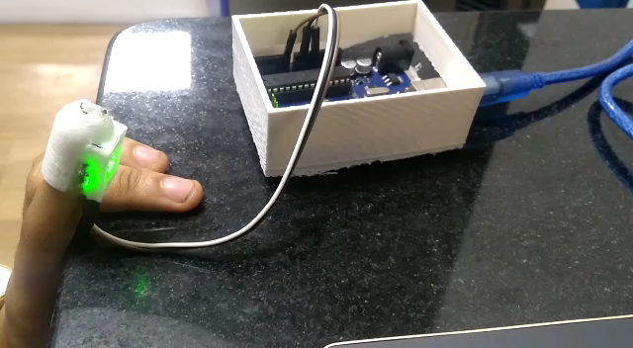
Work Done Till Now

Slide 6
Working Pattern (for next 3 months)
Analysis
Configuration
Programming

Slide 7
Applications and Deliverables
The main application is in military. It can be worn by soldiers for border patrolling and small squad missions.
It can also be worn by patients for their remote and continuous health monitoring.

Slide 8
Time Line
August
Further Research on Idea
Configuring pulse sensor
1-15 Sept
Testing, calibration of sensors
Interfacing of components
15-30 Sept
Programming of sensors
Interfacing of battery and communication module
1-10 Oct
Analysis and interpretation of data collected
Final assembly of project
Future Scope
Using thermoelectric generators for human body heat harvesting
Making project energy efficient

Slide 9
Thank You

